Slide 1
Discrete Mathematics (CSC 1204)
9.1 Introduction to Trees

Slide 2
What is a Tree?
Definition: A tree is a connected undirected graph with no simple circuits.

Slide 3
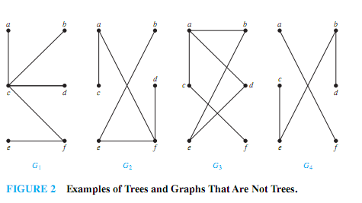
Example 1
Which of the graphs shown in Figure 2 are trees?

Slide 4
Example 1
Solution:
G1 and G2 are trees, because both are connected
graphs with no simple circuits.
G3 is not a tree because e, b, a, d, e is a simple circuit in this graph.
Finally, G4 is not a tree because it is not connected.

Slide 5
Theorem 1
An undirected graph is a tree if and only if there is a unique simple path between any two of its vertices.

Slide 6
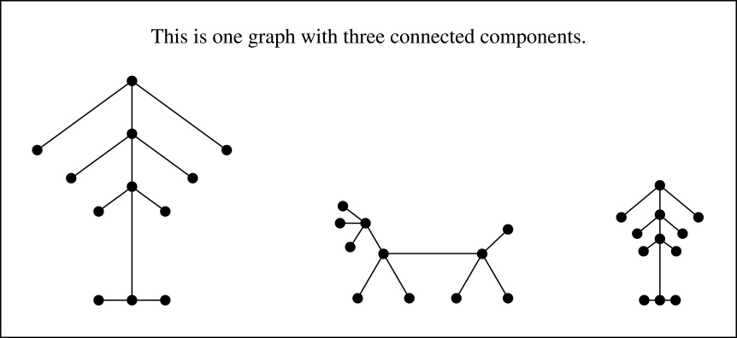
Forest
A forest is a graph that has no simple circuit, but is not connected. Each of the connected components in a forest is a tree.
Example of a Forest

Slide 7
Rooted Tree
Rooted tree: A rooted tree is a tree in which one vertex has been designated as the root and every edge is directed away from the root.
We can change an unrooted tree into a rooted tree by choosing any vertex as the root
Different choices of the root produce different rooted trees

Slide 8
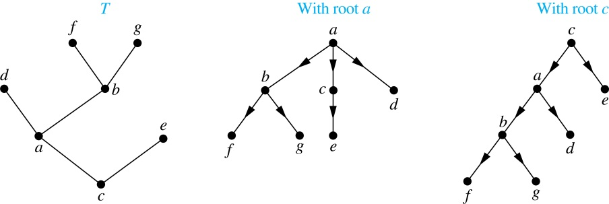
A Tree and Rooted Trees Formed by Designating Two Roots
The rooted trees formed by designating a to be root and c to be the root

Slide 9
Ordered Rooted Tree
Definition: An ordered rooted tree is a rooted tree where the children of each internal vertex are ordered.
We draw ordered rooted trees so that the children of each internal vertex are shown in order from left to right
Definition: A binary tree is an ordered rooted where each internal vertex has at most two children. If an internal vertex of a binary tree has two children, the first is called the left child and the second the right child. The tree rooted at the left child of a vertex is called the left subtree of this vertex, and the tree rooted at the right child of a vertex is called the right subtree of this vertex.

Slide 10
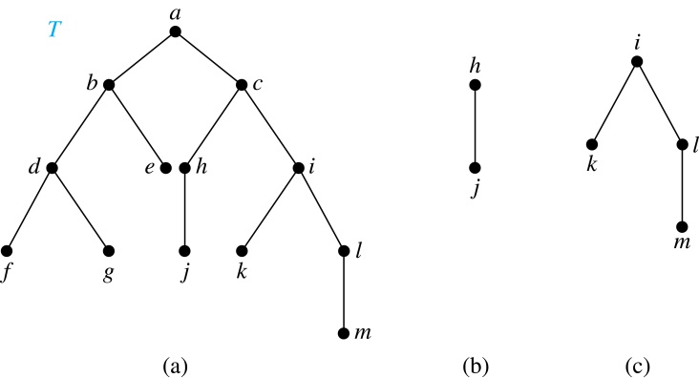
Example 4 @page 627
Consider the binary tree T.
(i) What are the left and right children of d?
(ii) What are the left and right subtrees of c?
Solution:
(i) The left child of d is f and the right child is g.
(ii) The left and right subtrees of c are displayed in
(b) and (c).

Slide 11
Rooted Tree Terminologies
Parent: If v is a vertex of a rooted tree other than the root, the parent of v is the unique vertex u such that there is a directed edge from u to v.
Note that such a vertex is unique
Child: When u is a parent of v, v is called a child of u.
Siblings: Vertices with the same parent are called siblings.
Leaf: A vertex of a rooted tree is called a leaf if it has no children.
Internal vertex: A vertex that has children is called internal vertex.
Note: The root is an internal vertex unless it is the only vertex in the graph, in which case it is a leaf.

Slide 12
Rooted Tree Terminologies
Ancestor(s): The ancestors of a vertex other than the root are the vertices in the path from the root to this vertex, excluding the vertex itself and including the root.
Descendant(s) : The descendants of a vertex v are those vertices that have v as an ancestor.
Subtree: If a is a vertex in a tree, the subtree with a as its root is the subgraph of the tree consisting of a and its descendants and all edges incident to these descendants.

Slide 13
Illustration of Tree Terminology
Root
Level 0
R
Level 1
S
T
Internal Vertex
Level 2
X
U
V
W
Leaf
Level 3
Y
Z
Siblings
Child of X
Subtree rooted at S
Parent of Z and Y

Slide 14
Illustration of Tree Terminology
root
a
internal vertex
parent of g & f
b
c
child of c
d
e
f
g
leaf
siblings
h
i

Slide 15
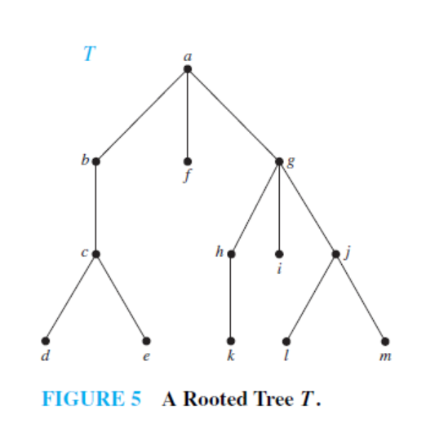
EXAMPLE 2
In the rooted tree T (with root a) shown in Figure 5, find the parent of c, the children of g, the siblings of h, all internal vertices, and all leaves. What is the subtree rooted at g?

Slide 16
Solution of EXAMPLE 2
The parent of c is b.
The children of g are h, i, and j .
The siblings of h are i and j .
The internal vertices are a, b, c, g, h, and j .
The leaves are d, e, f , i, k, l, and m.
The subtree rooted at g is shown in Figure 6(next slide)

Slide 17
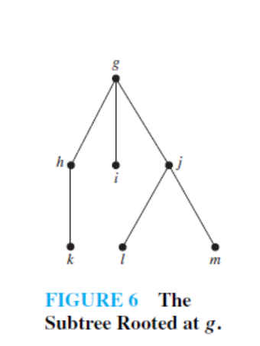
Solution of EXAMPLE 2
The subtree rooted at g is shown in Figure 6

Slide 18
m-ary tree, full m-ary tree, binary tree
A rooted tree is called an m-ary tree if every internal vertex has no more than m children.
The tree is called a full m-ary tree if every internal
vertex has exactly m children.
An m-ary tree with m = 2 is called a binary tree.

Slide 19
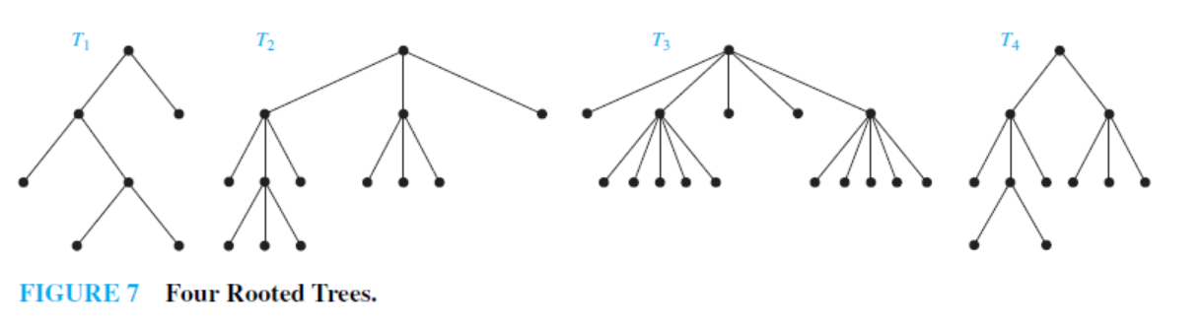
Example 3
Are the rooted trees in Figure 7 full m-ary trees for some positive integer m?

Slide 20
Solution of Example 3
T1 is a full binary tree because each of its internal vertices has
two children.
T2 is a full 3-ary tree because each of its internal vertices has three children.
In T3 each internal vertex has five children, so T3 is a full 5-ary tree.
T4 is not a full m-ary tree for any m because some of its internal vertices have two children and others have three children.
Example 4 : Practice @ Home

Slide 21
Properties of Trees
Theorem: A tree with n vertices has n − 1 edges.
Theorem: A full m-ary tree with i internal vertices contains n = mi + 1 vertices.

Slide 22
Properties of Trees
Theorem: A full m-ary tree with
n vertices has i = (n − 1)/m internal vertices and
l = [(m − 1)n + 1] / m leaves,
i internal vertices has n = mi + 1 vertices and
l = (m − 1)i + 1 leaves,
iii. l leaves has n = (ml − 1)/(m − 1) vertices and
i = (l − 1)/(m − 1) internal vertices

Slide 23
Exercise
17. How many edges does a tree with 10,000 vertices have?
18. How many vertices does a full 5-ary tree with 100 internal
vertices have?
19. How many edges does a full binary tree with 1000 internal
vertices have?
20. How many leaves does a full 3-ary tree with 100 vertices
have?
27. Construct a complete binary tree of height 4 and a complete 3-ary tree of height 3.

Slide 24
Exercise
17. How many edges does a tree with 10,000 vertices
have?
Solution:
Here, n = 10000
e = n –1 = 9999

Slide 25
Exercise
18. How many vertices does a full 5-ary tree with 100
internal vertices have?
Solution:
Here, m = 5, i = 100
Therefore, n = mi + 1 = 5.100 + 1 = 501

Slide 26
Exercise
19. How many edges does a full binary tree with 1000 internal vertices have?
Solution:
Here, m = 2, i = 1000
So, n = mi + 1
= 2.1000 + 1
= 2001
Therefore, e = n – 1
= 2001 –1
= 2000

Slide 27
Exercise
20. How many leaves does a full 3-ary tree with 100 vertices have?
Solution:
Here, m = 3, n = 100
l = [(m –1)n + 1 ]/m
= [(3 –1)100 + 1 ]/ 3
= 201/3
= 67

Slide 28
Level of vertices and height of trees
When working with trees, we often want to have rooted trees where the subtrees at each vertex contain paths of approximately the same length.
To make this idea precise we need some definitions:
The level of a vertex v in a rooted tree is the length of the unique path from the root to this vertex.
The height of a rooted tree is the maximum of the levels of the vertices.

Slide 29
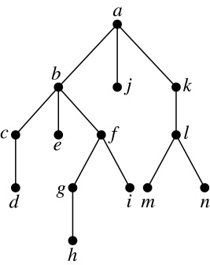
Level of vertices and height of trees
Example:
(i) Find the level of each vertex in
the tree to the right.
(ii) What is the height of the tree?
Solution:
(i) The root a is at level 0. Vertices b, j, and k are at level 1.
Vertices c, e, f, and l are at level 2. Vertices d, g, i, m, and n are at level 3.
Vertex h is at level 4.
(ii) The height is 4, since 4 is the largest level of the vertices in this tree
(vertex h).

Slide 30
Illustration of Level of vertices
level 0
level 1
level 2
level 3

Slide 31
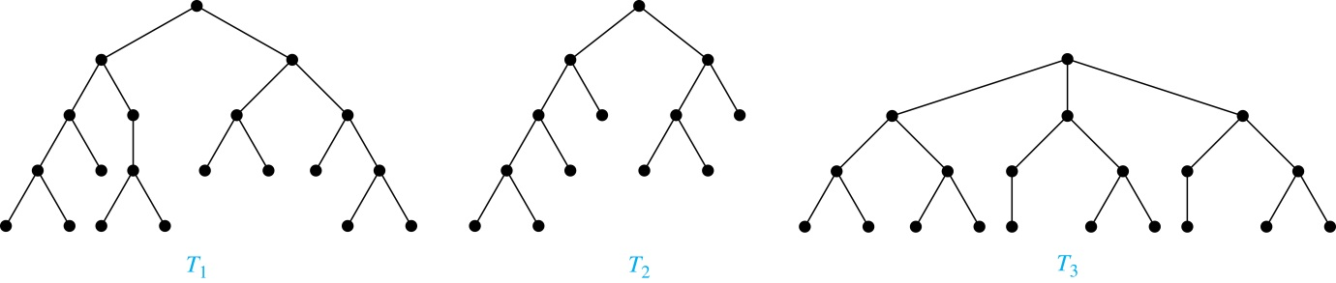
Balanced m-ary Trees
Definition: A rooted m-ary tree of height h is balanced if all leaves are at levels h or h − 1.
Example: Which of the rooted trees shown below is balanced?
Solution: T₁ and T₃ are balanced, but T₂ is not because it has leaves at levels 2, 3, and 4.

Slide 32
The Bound for the Number of Leaves in an m-ary Tree
Theorem 5: There are at most m^{h} leaves in an m-ary tree of height h.

